Slide 1
AMP LAB 02
Fragments

Slide 2
Lab Summary
In this lab you will develop an application using two fragments.
The first fragment displays two text fields that you can use to type a message header and message body.
Then when you press the Send Message button on the first fragment, the message will be displayed on the second fragment
The next two slides show the application layout for both landscape and portrait orientation

Slide 3
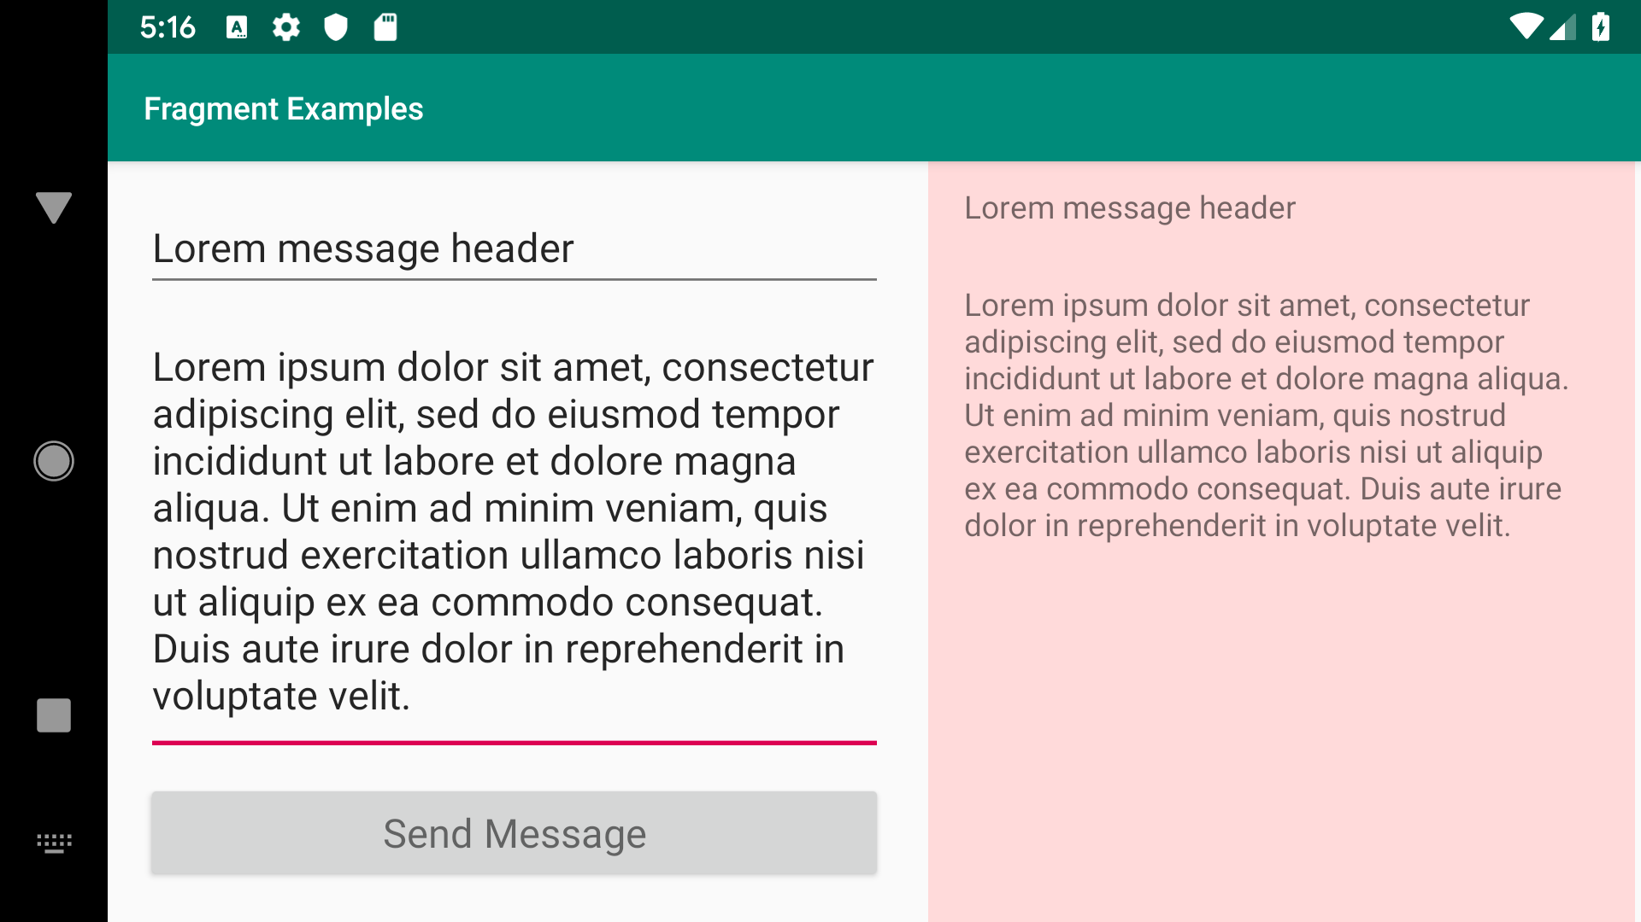
Lab Summary
Two fragments side to side in the landscape orientation

Slide 4
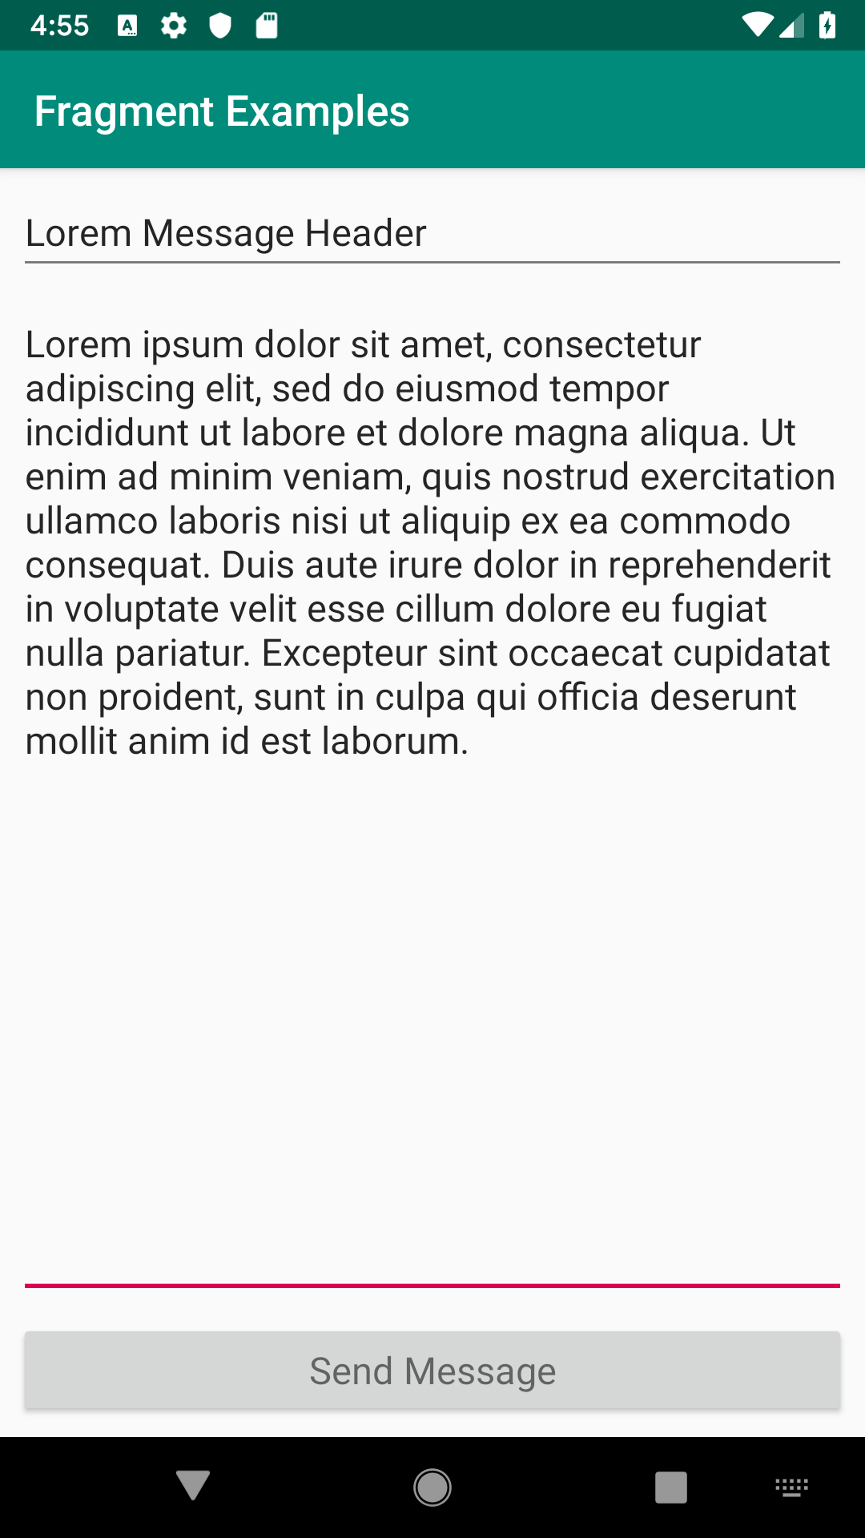
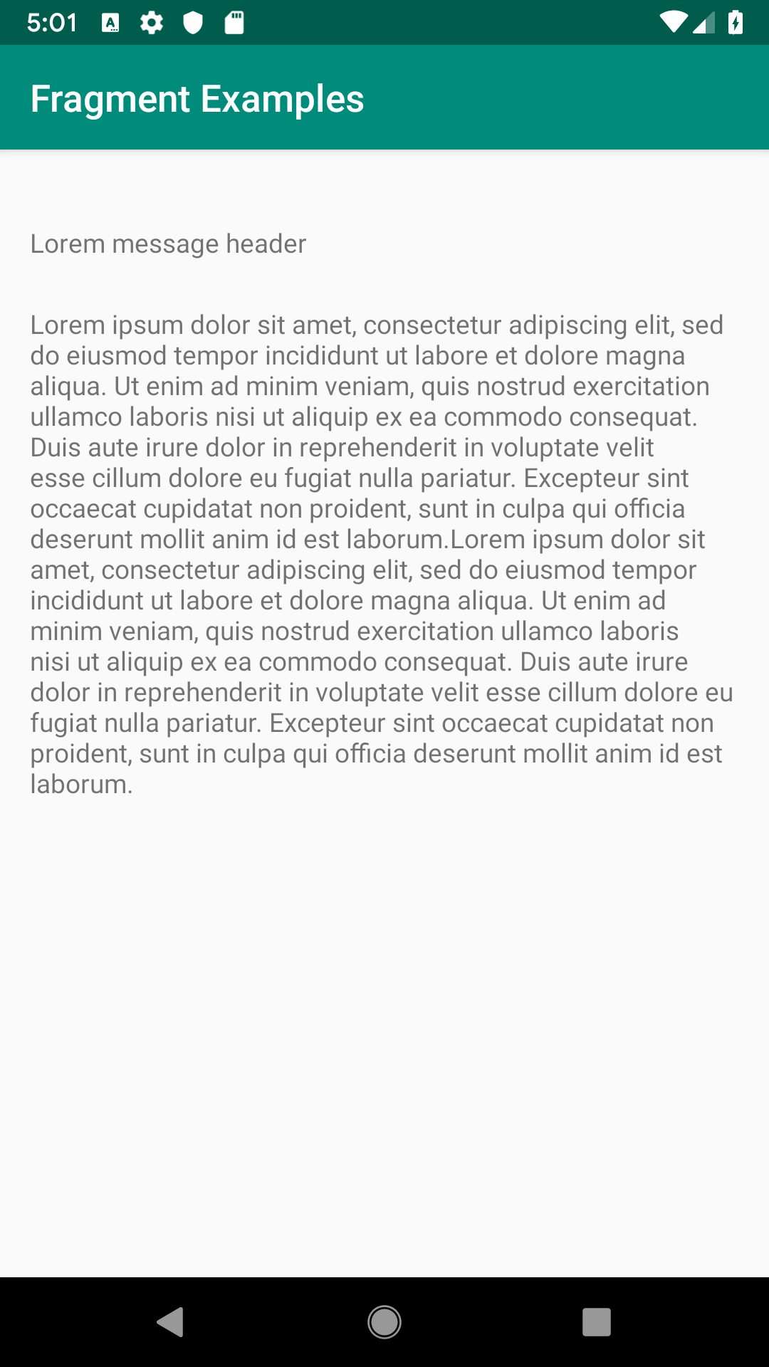
Lab Summary
Two fragments in two different activities in portrait orientation

Slide 5
Learning Outcomes
After completing this lab session, you should be able to
Create and use fragments statically and dynamically
Pass arguments to fragments
Use fragment transactions to manage fragments
Create and use factory method to get instances of fragments
Fragment-to-Fragment communication using interface
Use fragment lifecycle callback methods such as onAttach and onCreateView
Familiarize yourself with Kotlin’s companion object

Slide 6
Create a new project
Go to File->New->New Project
Select Empty Activity
Give your project a name (MessageFragmentApplication)
Make sure to select Kotlin as a language
Also select the Use androidx.* artifacts option

Slide 7
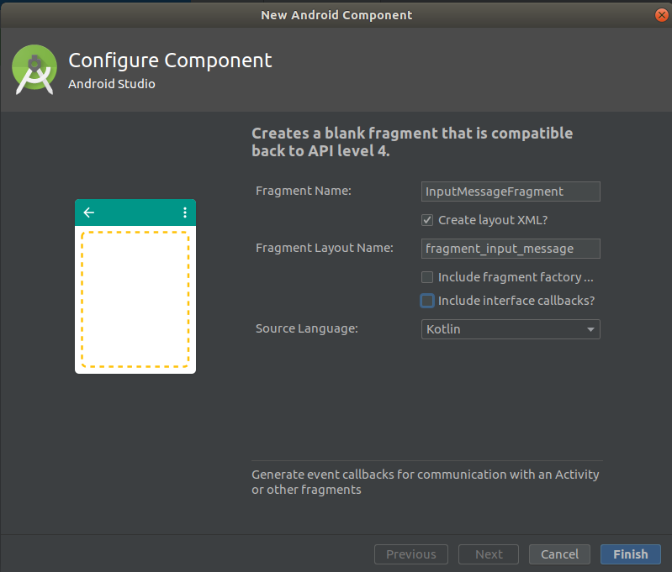
Creating Fragments
Letus start by creating two fragments
Right click on your package root and select New->Fragment->Fragment(Blank)
Give it a name (InputMessageFragment)
Untick both Include fragment factory and Include interface callbacks? options

Slide 8
Creating Fragments
Letus start by creating two fragments
Follow the same procedure to create the second fragment
Give it a name (ShowMessageFragment)
You should also uncheck the two options as before

Slide 9
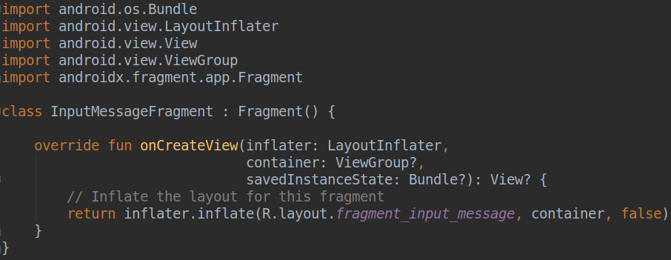
InputMessageFragment
Your code should look like the following, you can remove the generated code shown at the top

Slide 10
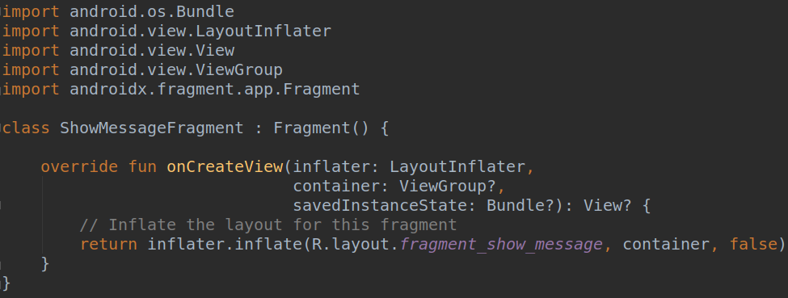
ShowMessageFragment
Your code should look like the following, you can remove the generated code shown at the top

Slide 11
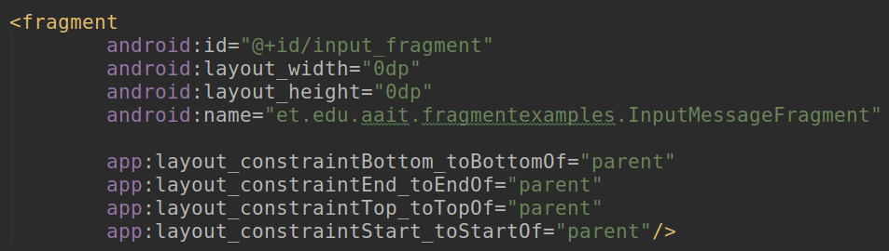
Add Fragment Statically
Open activity_main.xml file and remove any widget inside the default ConstraintLayout and add the <fragment /> tag shown below
Note the android:name attribute, it specifies InputMessageFragment

Slide 12
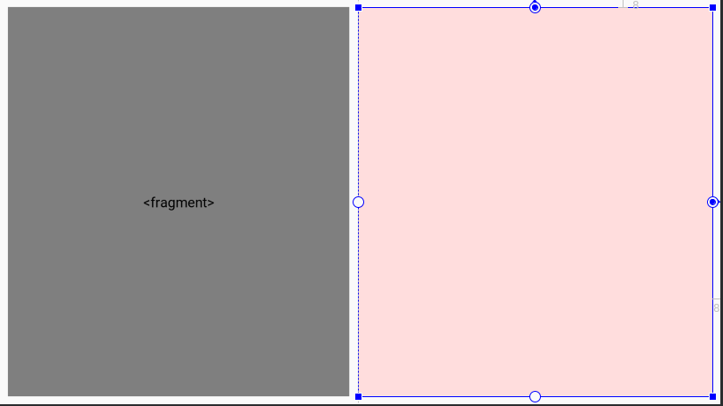
Define layout for landscape orientation
The layout specified in the activity_main.xml can work well for the portrait orientation.
We have more space in the landscape orientation to place two fragments side to side

Slide 13
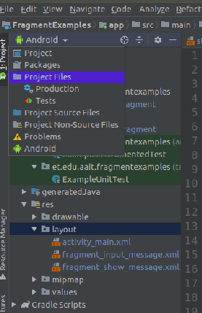
Define layout for landscape orientation
Change the project file tree view from Android view to Project view, then
Right click on res directory and create a new directory with name layout-land
Copy the activity_main.xml file from layout directory to layout-land directory (do not rename the file name when prompted)
Change the project view back to Android

Slide 14
Define layout for landscape orientation
Open layout-land/activity_main.xml file in Design mode
Divide the screen into two halfs
Place <fragment> on the left
Select InputMessageFragment
Place <FrameLayout> on the right
Give id of input_fragment for the fragment
Give id of show_frame for the FrameLayout

Slide 15
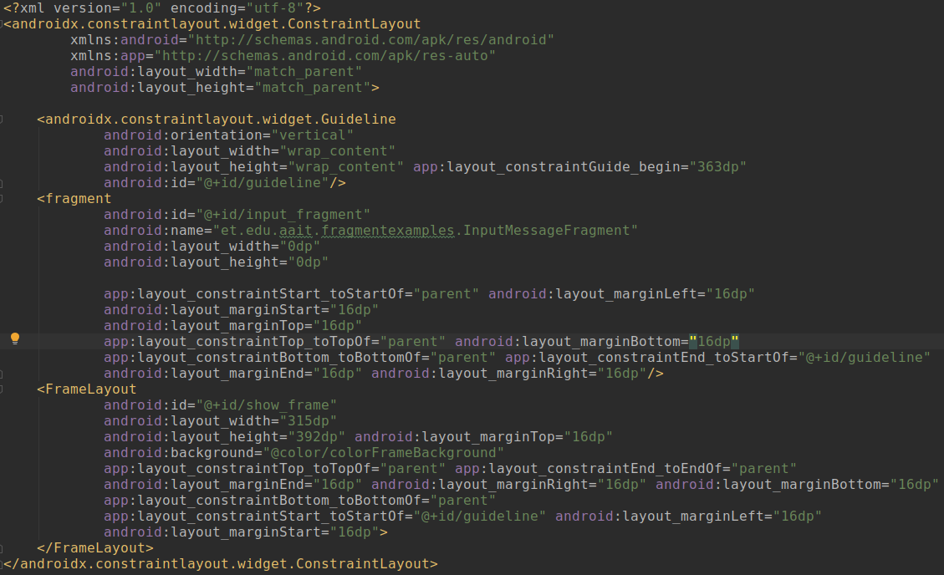
Define layout for landscape orientation
The text view of layout-land/activity_main.xml file

Slide 16
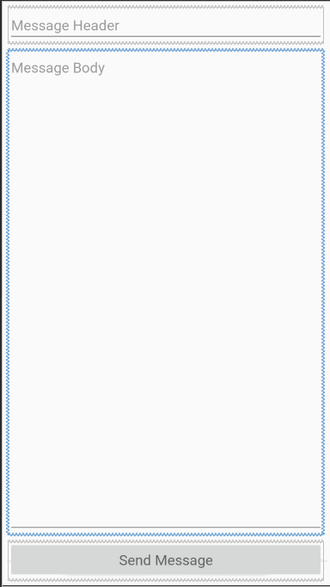
Put widgets for accepting messages
Open fragment_input_message.xml file, change the layout to ConstraintLayout and place Plain Text, Multiline Text, and Button widgets as shown in the right
Give them Ids as shown below
The top widget - input_header_et
The middle widget - input_body_et
The bottom widget - send_message_btn

Slide 17
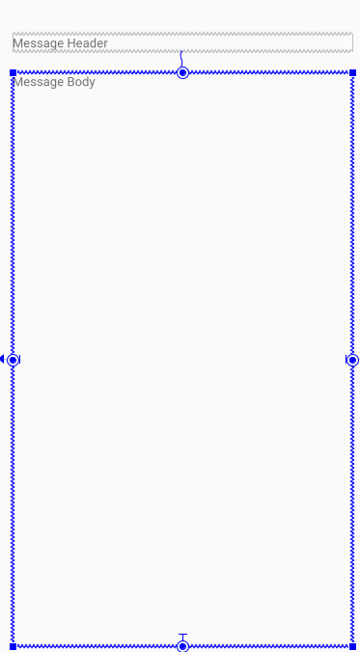
Put widgets for displaying messages
Open fragment_show_message.xml file, change the layout to ConstraintLayout and place one TextView for showing the message header and another one for showing the message body as shown in the right
Give them Ids as shown below
The top widget - show_header_tv
The bottom widget - show_body_tv

Slide 18
InputMessageFragment
Open InputMessageFragment then do the following inside onCreateView method
Get handler for the widgets shown in the input_message_fragment.xml layout file
Add click listener for the button widget
Your code should look like similar to the one shown in the next slide

Slide 19
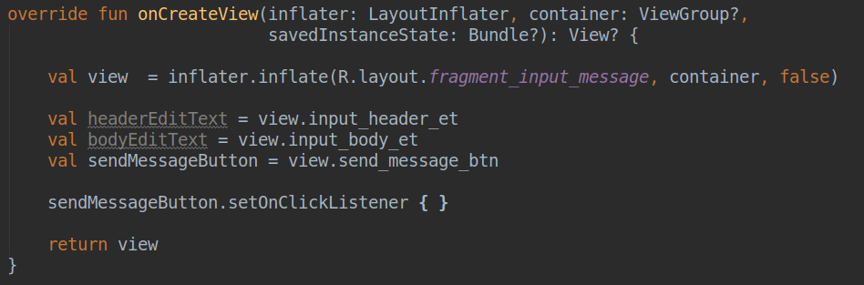
InputMessageFragment

Slide 20
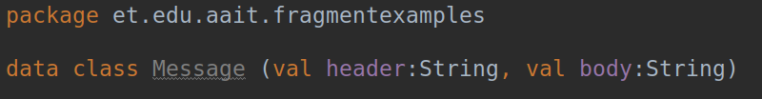
Message data class
Let us create a data class called Message to manage the message data

Slide 21
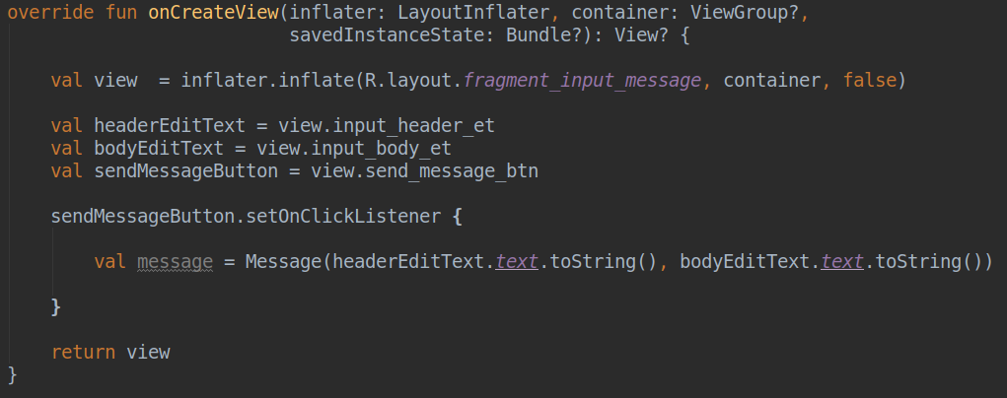
Putting data into a Message object
Go back to InputMessageFragment class and update the onCreateView method as shown below

Slide 22
Fragment to Fragment Communication
We now have the message that the user typed in the InputMessageFragment fragment inside the message object but it is not recommended to place the code to create and manage the ShowMessageFragment fragment inside this fragment (https://developer.android.com/training/basics/fragments/communicating)
One of the recommended approach for managing fragment-to-fragment communication is through the hosting activity
You can do this by using interfaces (check the link provided above for the details)

Slide 23
Fragment to Fragment Communication
Steps
Create an interface inside InputMessageFragment
Make MainActivity implement the interface
Get a handle for the interface implementer inside the InputMessageFragment
Use the implemented interface inside the InputMessageFragment

Slide 24

Fragment to Fragment Communication
Create an interface inside InputMessageFragment

Slide 25
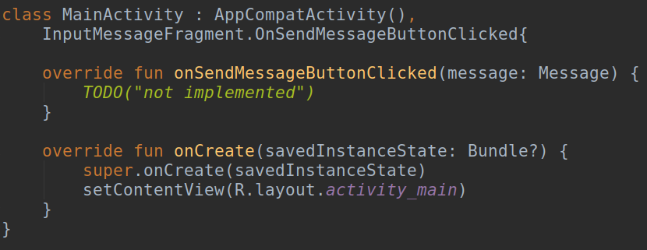
Fragment to Fragment Communication
Make MainActivity implement the interface

Slide 26
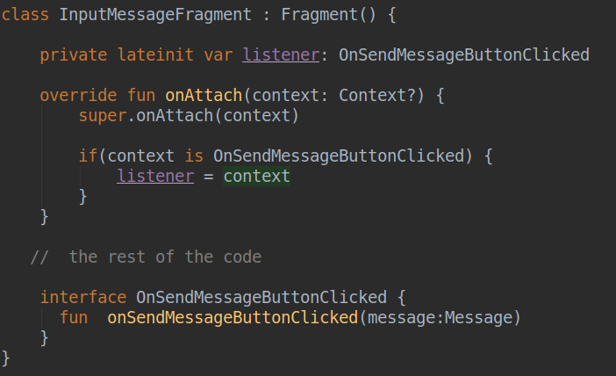
Fragment to Fragment Communication
Get a handle for the interface implementer inside the InputMessageFragment

Slide 27
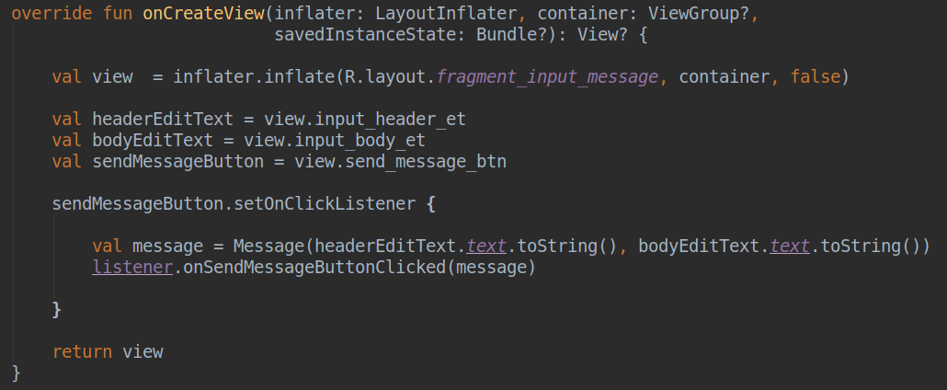
Fragment to Fragment Communication
Use the implemented interface inside the InputMessageFragment

Slide 28
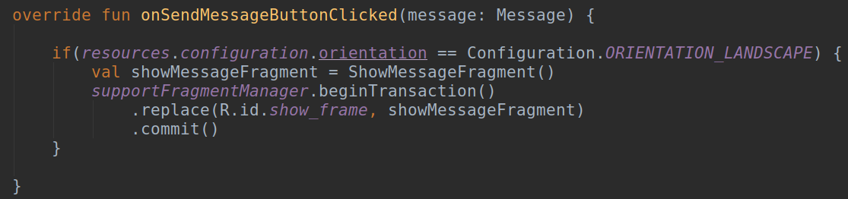
Add Fragment dynamically
Go to MainActivity class and update the onSendMessageButtonClicked method as follows
Note the if expression, the code should only run in the landscape orientation

Slide 29
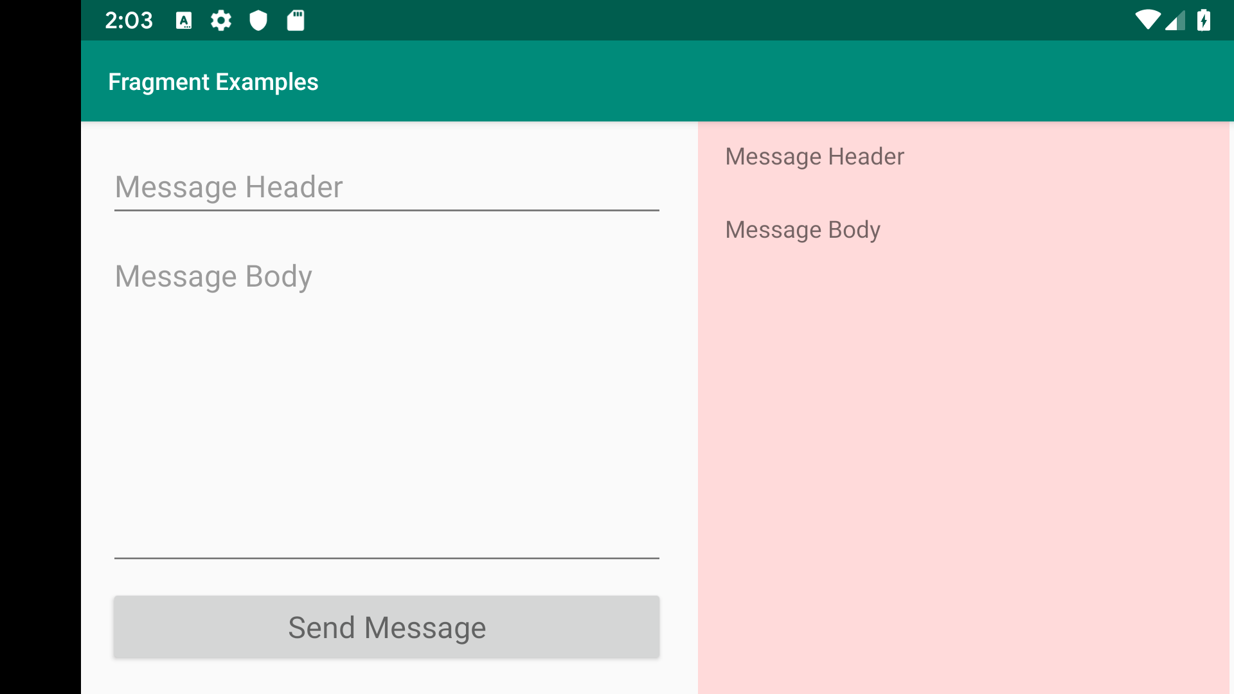
Add Fragment dynamically
Run the application in landscape orientation and test it.

Slide 30
Passing arguments to fragment
When you press the Send Message button you will see a new fragment on the right side with the default “Message Header” and “Message Body” text regardless of the text you typed in the left fragment
Let us now see how to pass arguments to the second fragment and how to extract them

Slide 31
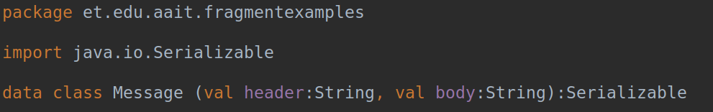
Passing arguments to fragment
If you want to pass objects as argument you have to use Serializable object.
To pass a Message object as argument, we have to make our Message class serializable as shown below

Slide 32
Passing arguments to fragment
Here are the steps you can follow to pass arguments
Create a Bundle object
Use its methods such as putSerializable()
Use fragments’ arguments property to pass your argument
The following slide shows these steps in action

Slide 33
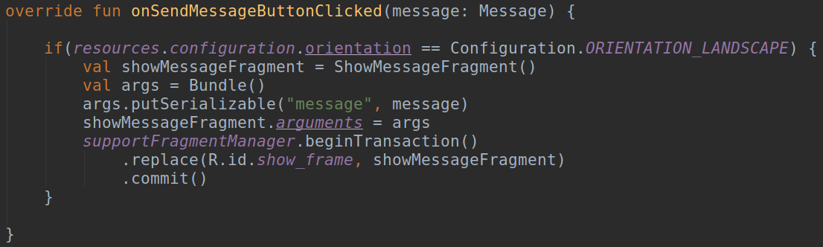
Passing arguments to fragment
Update the onSendMessageButtonClicked() inside MainActivity class

Slide 34
Fragment Factory Method
Creating fragment and passing arguments is a common thing to do, you might need to repeat this steps if you want to reuse ShowMessageFragment in other activity for example
Therefore, it is a good practice to place the code for creating fragment and passing arguments in one place at the fragment class as factory method
You can achieve this in Kotlin by using companion object
The next slide show you how to do this

Slide 35
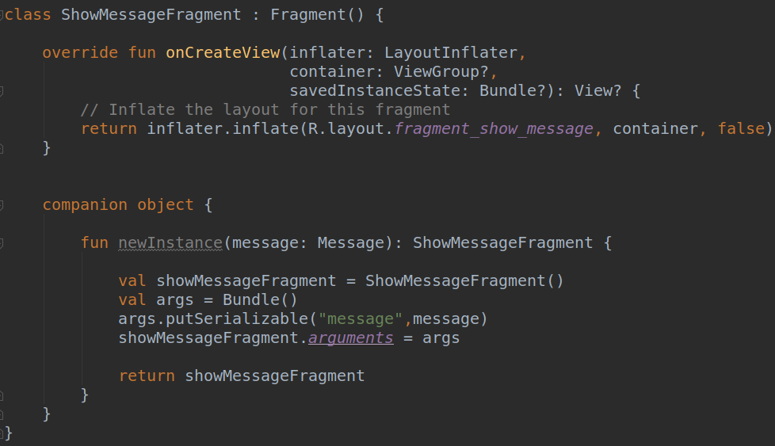
Fragment Factory Method
Add companion object inside ShowMessageFragment

Slide 36
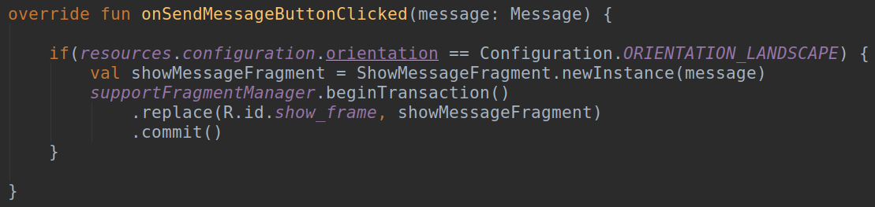
Fragment Factory Method
Update onSendMessageButtonClicked class to use the factory method

Slide 37
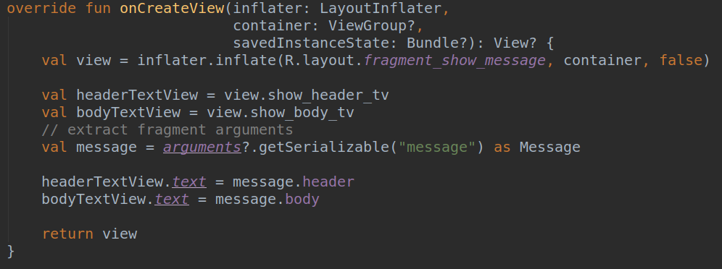
Extracting and using fragment arguments
Open ShowMessageFragment class and update the onCreateView method

Slide 38
Extracting and using fragment arguments
Now you can run the app and test if it is working as expected

Slide 39
App code for land-scape orientation
The full code for the land-scape orientation can be found below
https://github.com/betsegawlemma/AMP-LAB-02-Fragment/tree/master

Slide 40
ShowMessageFragment (Portrait)
Incase of portrait orientation, we can display ShowMessageFragment
In a new activity
In the existing activity by replacing InputMessageFragment

Slide 41
ShowMessageFragment in new Activity
Create a new Empty Activity in your package root, you can call it ShowMessageActivity

Slide 42
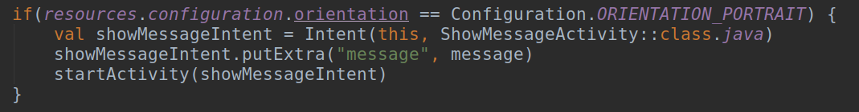
ShowMessageFragment in new Activity
Open MainActivity class and insert the following code next to the if expression that handles the landscape orientation case
Here the ShowMessageActivity activity will be started when the Send Message button is clicked in portrait orientation with the message object passed as an intent parameter

Slide 43
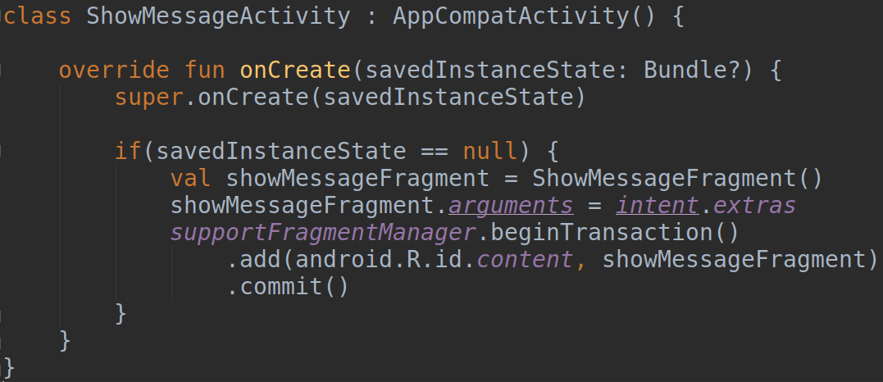
ShowMessageFragment in a new Activity
Goto ShowMessageActivity class and update the onCreate method as follows

Slide 44
ShowMessageFragment in a new Activity
Note the following in the previous code
The intent argument is extracted and passed to the ShowMessageFragment argument
The andorid.R.id.content ID value indicates the ViewGroup of the entire content area of an Activity
The full application code is found in the following github branch
https://github.com/betsegawlemma/AMP-LAB-02-Fragment/tree/portrait-new-activity

Slide 45
Run and Test the app

Slide 46
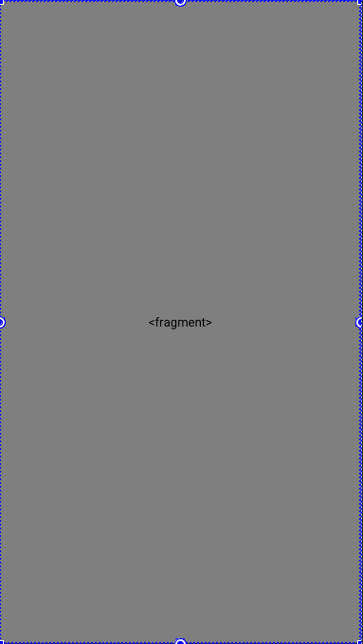
ShowMessageFragment with replacement
Without creating a new Activity we can display ShowMessageFragment by replacing the InputMessageFragment fragment in the existing activity
To do this, we need to place InputMessageFragment dynamically so as to replace it dynamically
Replace the <fragment> shown with FrameLayout
Open the activity_main.xml layout file remove the <fragment> and put <FrameLayout> instead

Slide 47

ShowMessageFragment with replacement
Give an Id to the FrameLayout - portrait_frame

Slide 48
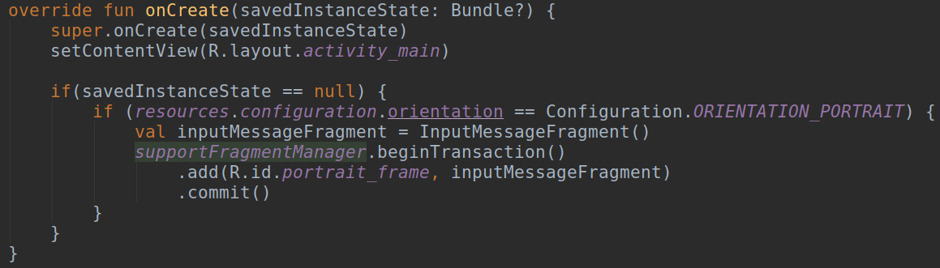
ShowMessageFragment with replacement
Open the MainActivity class and update the onCreate method as shown below. We are now placing InputMessageFragment dynamically

Slide 49
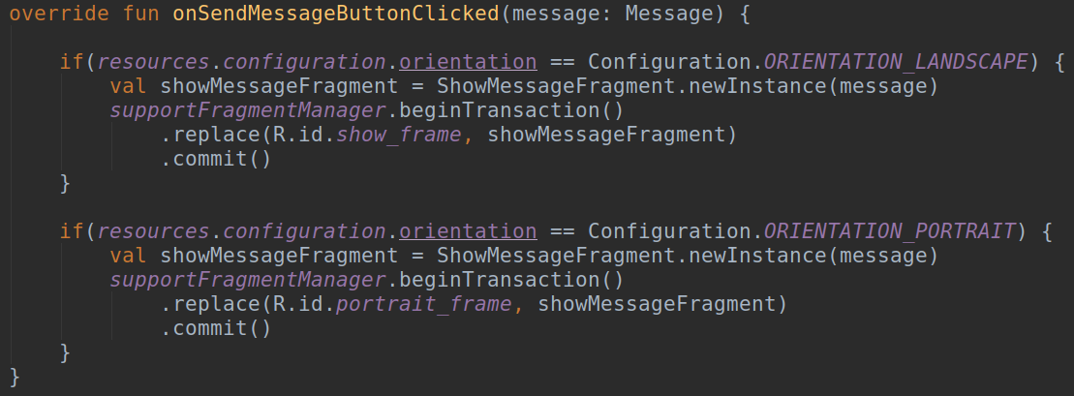
ShowMessageFragment with replacement
Update the second if expression in MainActivity class inside onSendMessageButtonClicked method as shown

Slide 50
ShowMessageFragment with replacement
The application should work similar to the previous one except that if you press the back button after getting to ShowMessageFragment, the application exits rather than showing you the InputMessageFragment.
Update the onCreate method on the MainActivity class as shown in the next slide to fix this issue.

Slide 51
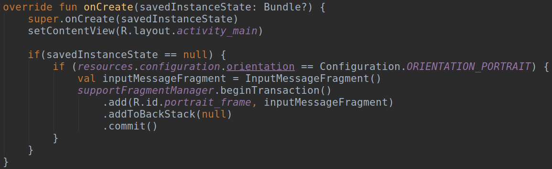
ShowMessageFragment with replacement

Slide 52
ShowMessageFragment with replacement
The full code of this version can be found in the following github branch
https://github.com/betsegawlemma/AMP-LAB-02-Fragment/tree/portrait-replace-fragment

Slide 53
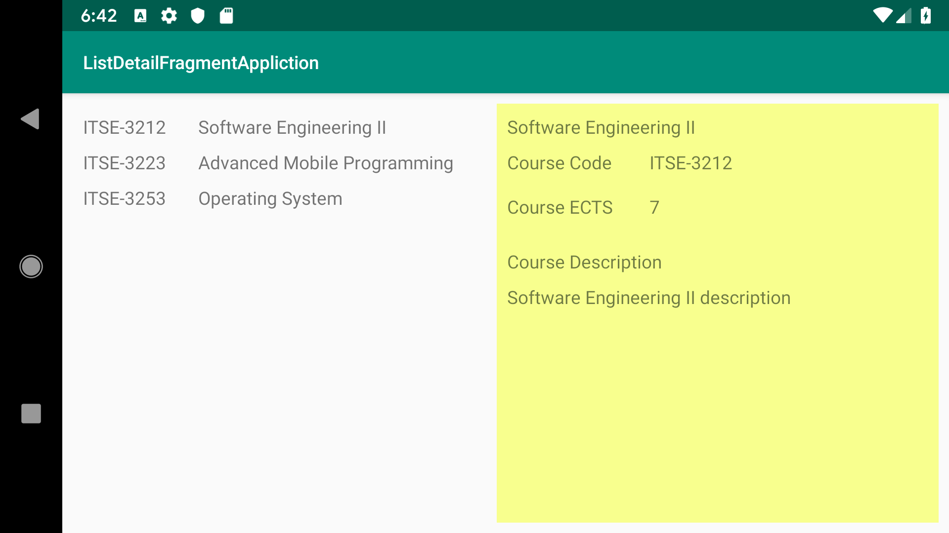
Other Example
You can find below a link to another fragment example applied on List/Detail application used in AMP-LAB-01
https://github.com/betsegawlemma/AMP-LAB-02-Fragment-RecyclerView

Slide 54
ViewPager

Slide 55
ViewPager
You can slide between fragments using ViewPager
In this lesson you will learn how to do screen slides with a ViewPager
We can accomplish this by following the following three steps
Add a ViewPager
Create Adapter for the ViewPager
Connect the ViewPager and the Adapter

Slide 56
ViewPager
Let us start by creating a new project called ViewPagerExample (make sure to select the androidx option)
Goto activity_main.xml layout file and remove the default TextView widget

Slide 57
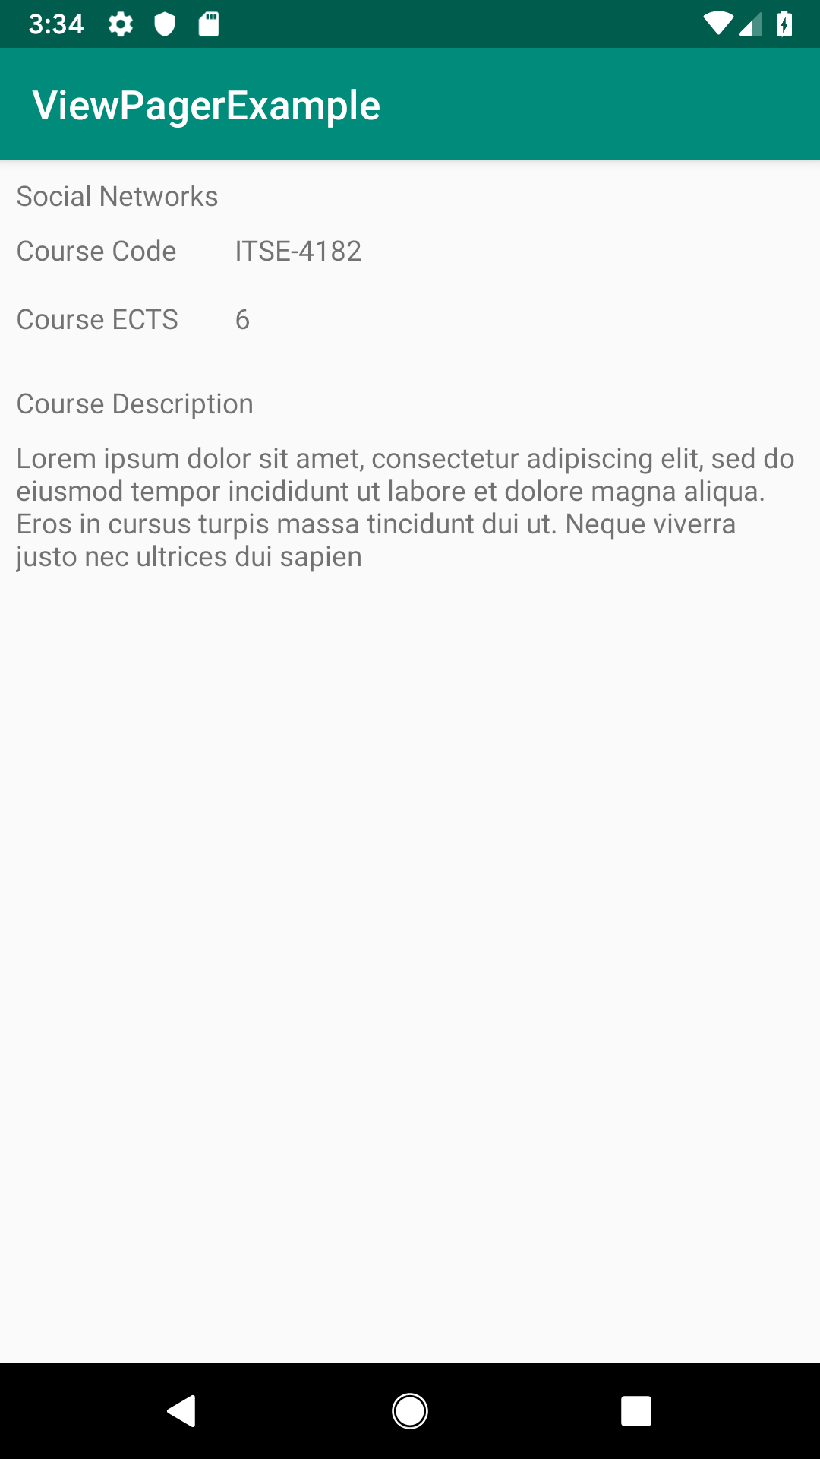
ViewPager Setup
As a content for each slide we will use ITSC courses as an example

Slide 58
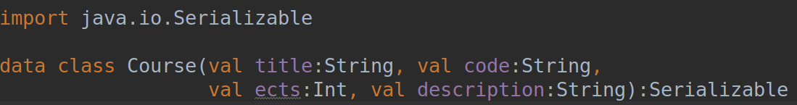
ViewPager Setup
Create a Course data class for holding course info

Slide 59
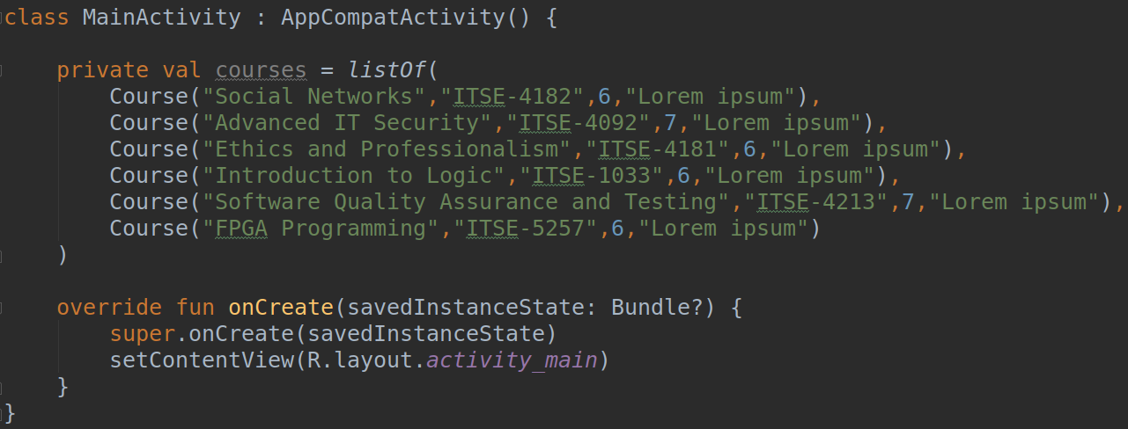
ViewPager Setup
Goto MainActivity and create courses list

Slide 60
Create a Fragment
We will use a fragment to display each course information
Right click on your package and select New->Fragment->Fragment (Blank)
Call it CourseFragment
Make sure to uncheck the factory and interface callback options

Slide 61
Create a Fragment
Open the generated fragment_course.xml file and place 7 TextView widgets as shown in the right.
Three of the TextViews are used for the labels - Course Code, Course ECTS and Course Description
Update the Ids of the remaining ones as follows
detail_title_tv, detail_code_tv, detail_ects_tv and detail_description_tv

Slide 62
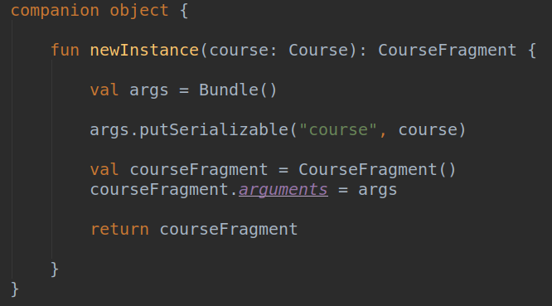
Create a Fragment
Open CourseFragment class and add the following factory method

Slide 63
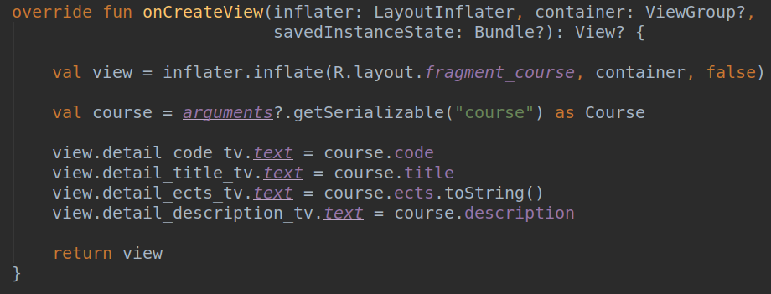
Create a Fragment
While still in CourseFragment class, update its onCreateView method

Slide 64
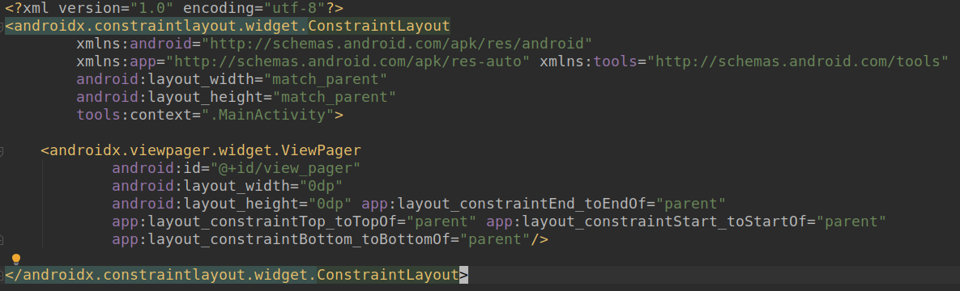
ViewPager
Update your activity_main.xml file as follows
Notice the ViewPager object and its Id

Slide 65
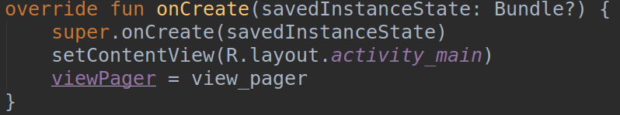
ViewPager
Open MainActivity and create the following property
We will use this property to store a handler for the ViewPager object added in the previous slide
Update the onCreate method to instantiate the viewPager property

Slide 66
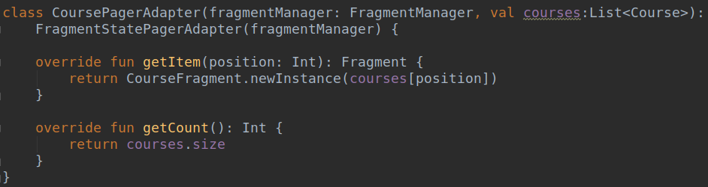
Create PagerAdapter
Create CoursePagerAdapter class as shown below
It should have two constructor arguments and it should also inherit from FragmentStatePagerAdapter class

Slide 67
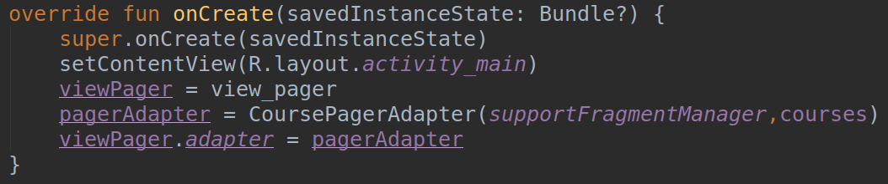
Wiring PagerAdapter with ViewPager
Open MainActivity class and add the following property
Update the onCreate method

Slide 68
Test the App
Run and test the application, you should be able switch to different fragments by sliding
Below is a github link to the full code
https://github.com/betsegawlemma/AMP-LAB-02-ViewPager
Reference
https://developer.android.com/training/animation/screen-slide

Slide 69
Lab-02 Advanced Mobile Programming
Course Title | Advanced Mobile Programming
Course Code | ITSE-3123
ECTS | 7
Department | Center of Information Technology and Scientific Computing, AAiT, AAU
Instructor | Mr. Betsegaw Lemma (betsegaw.lemma@aait.edu.et)
Academic Year | 2018/19
Semester | II

